Slide 1

CS-242
UNIX OPERATING SYSTEM

Slide 2
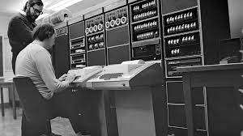
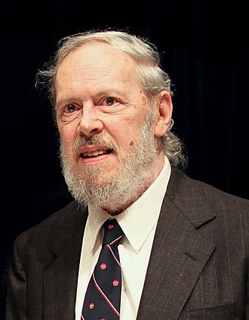

Slide 3
Introduction to UNIX
UNIX is a popular operating system developed by Dennis Richie at Bell Laboratories in USA.
Unix was written in the C programming language.
First portable operating system

Slide 4
UNIX FILE SYSTEM
In Unix everything veers around the following two basic concepts:
Files
Processes
Users organize applications using files and processes.
A file is the smallest unit in which the information is stored.
A program text is a file.
A program in execution is a process.

Slide 5
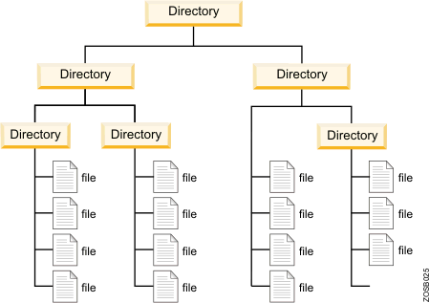
UNIX FILE SYSTEM
All data in Unix is organized into files.
All files are organized into directories.
These directories are organized into a tree-like structure called the file system.

Slide 6
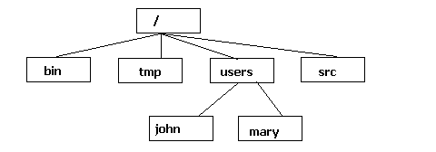
UNIX FILE SYSTEM
Command-driven environment
Home directory denoted by ~
All paths emanate from root directory.
Current directory is denoted by a (.)
Parent of current directory (..)
Spaces are not permitted within the file path names

Slide 13
COMMANDS
mkdir – Make a directory
rmdir – Remove Directory
touch – Creates a file in the current directory
cat – create, view, concatenate files.
Rm – remove a file from the current directory
ls –list all the files within a directory
cd –brings you back to the home directory
pwd –print the present working directory

Slide 14
mkdir command
Syntax - mkdir <dirname>
mkdir stands for “make directory".
Creates a new directory under the current location with the name dirname.

Slide 15
mkdir command
Syntax - mkdir <dirname>
mkdir stands for “make directory".
Creates a new directory under the current location with name dirname.
Syntax - mkdir <dirname1> <dirname2> <dirname3> ...
This will make multiple directories.

Slide 16
rmdir command
Syntax – rmdir <dirname>
rmdir stands for “remove directory".
This command is used to delete a directory.
But will not be able to delete a directory including a sub- directory. It means, a directory has to be empty to be deleted.

Slide 17
touch command
Syntax - touch <filename>
Creates a file in the current directory with the name filename
The file created using touch command is empty means that on creation file has 0 characters and 0 lines.

Slide 18
cat command
cat command is very frequently used in Linux as it helps us to create, view, concatenate files.
1. To view a file
Syntax - cat <filename>
It will display the content of given filename.
2) To view multiple files
Syntax - cat <filename1> <filename2>

Slide 19
cat command
To view contents of a file preceding with line numbers Syntax - cat –n <filename>
It will display the file content along with line numbers
Create a file
Syntax - cat > <filename>
Combines all the files in filename(s) and outputs to create a new file Syntax - cat filenames(s) > <newfilename>

Slide 20
rm command
rm (short for remove) is a basic command on Unix and Unix-like operating systems used to remove files, directories and so on from file systems.
Syntax - rm <filename> - removing one file at a time.
Syntax - rm <filename1> <filename2> - removing more file at a time.

Slide 21
SOME USEFUL UNIX COMMANDS
exit | Exits from the current shell/terminal
clear | Clears the screen
date | Shows the current time and date
history | Shows the previously given command history.

Slide 22
Some more file/directory related commands
ls | Lists all the files within a directory
cd | By itself it brings you back to home directory.
cd <pathname> | Takes you to the directory described by the pathname.
pwd | Prints the name of the current working directory.

